Slide 1

Introduction to Software Testing By Dr. Praveen Kantha

Slide 2
project Scheduling

Slide 3
Issues in Project Management
Project is not completed on schedule.
Changing customer requirements affect on schedule.
Technical difficulties are generate.
Miscommunication among project management.
Essential software & hardware may be delivered late.
In large project, Software engineer perform multiple tasks parallel.
Tasks interdependencies are in project.
Risk is not considered at beginning of project.

Slide 4
project Scheduling
Project scheduling is responsible activity of project manager.
Project schedule is a mechanism that is used to communicate and know about that tasks are needed and has to be performed in project.
Project manager separate total work task in project into different activities.
Project Manager estimate time & recourses required to complete activities & organize them into coherent sequence.
Effective project scheduling leads to success of project, reduced cost and increased customer satisfaction.

Slide 5
project Scheduling
Software project scheduling is an activity that distributes estimated effort across the planned project duration by allocating the effort to specific software engineering tasks.
A project schedule is a document collecting all the work needed to deliver the project on time.
A project is made up of many tasks, and each task is given a start and end (or due date), so it can be completed on time.
Likewise, people have different schedules, and their availability and vacation or leave dates need to be documented in order to successfully plan those tasks.

Slide 6
project Scheduling
It is important to note, however, that the schedule evolves over time.
During early stages of project planning, a macroscopic schedule is developed.
This type of schedule identifies all major software engineering activities and the product functions to which they are applied.
As the project gets under way, each entry on the macroscopic schedule is refined into a detailed schedule.
Here, specific software tasks (required to accomplish an activity) are identified and scheduled.

Slide 7
project Scheduling
Scheduling for software engineering projects can be viewed from two rather different perspectives.
In the first view :
An end-date for release of a computer-based system has already been established.
The software organization is constrained to distribute effort within the prescribed time frame.
In second view:
Assumes that rough chronological bounds have been discussed but that the end-date is set by the software engineering organization.
Effort is distributed to make best use of resources and an end-date is defined after careful analysis of the software.
Unfortunately, the first situation is encountered far more frequently than the second.

Slide 8
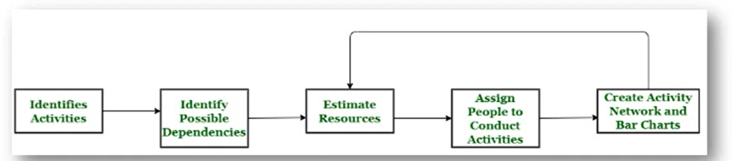
Project Scheduling Process
Identify all the functions / modules required to complete the project.
Break down large functions into small activities.
Determine the dependency among various activities.
Allocate resources to activities.
Assign people to conduct different activities.
Plan the beginning and ending dates for different activities.
Create Activity Network & Bar or Gantt charts.

Slide 9
Basic principles for software project scheduling
Compartmentalization:
The project must be compartmentalized into a number of manageable activities and tasks.
To accomplish compartmentalization, both the product and the process are decomposed.
Interdependency:
The interdependency of each compartmentalized activity or task must be determined.
Some tasks must occur in sequence while others can occur in parallel.
Some activities cannot commence until the work product produced by another is available.
Other activities can occur independently.

Slide 10
Basic principles for software project scheduling
Time allocation:
Each task to be scheduled must be allocated some number of work units (e.g., person-days of effort).
In addition, each task must be assigned a start date and a completion date that are a function of the interdependencies and whether work will be conducted on a full-time or part-time basis.
Effort validation:
Every project has a defined number of staff members.
As time allocation occurs, the project manager must ensure that no more than the allocated number of people have been scheduled at any given time.

Slide 11
Basic principles for software project scheduling
Defined responsibilities:
Every task that is scheduled should be assigned to a specific team member.
Defined outcomes:
Every task that is scheduled should have a defined outcome.
For software projects, the outcome is normally a work product (e.g., the design of a module) or a part of a work product.
Work products are often combined in deliverables.
Defined milestones:
Every task or group of tasks should be associated with a project milestone.
A milestone is accomplished when one or more work products has been reviewed for quality and has been approved.

Slide 12
Relationship Between People And Effort
In a small software development project a single person can analyze requirements, perform design, generate code, and conduct tests.
As the size of a project increases, more people must become involved.
There is a common myth that is still believed by many managers who are responsible for software development effort "If we fall behind schedule, we can always add more programmers and catch up later in the project."

Slide 13
Relationship Between People And Effort -
Unfortunately, adding people late in a project often has a disturbing effect on the project, causing schedules to slip even further.
The people who are added must learn the system, and the people who teach them are the same people who were doing the work.
While teaching, no work is done, and the project falls further behind.
In addition to the time it takes to learn the system, more people increase the number of communication paths and the complexity of communication throughout a project.
Although communication is absolutely essential to successful software development, every new communication path requires additional effort and therefore additional time.

Slide 14
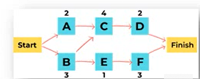
Project Scheduling Techniques
Critical Path Method:
It help you determine both longest and shortest possible time take to complete a project.
There are three essential elements: The tasks required to complete the project, Which tasks depend on the completion of others, A time estimate for each activity
Example:
There are four tasks in the project — A, B, C, and D.
Task B and D can only begin after task A completes, whereas task C has no such restriction.
Task A will be time-sensitive as any delay in its completion can delay in task B & D.
Called as Critical Task.
This helps in identifying and separating the independent variables.
Finally, it adds milestones to the project.

Slide 15
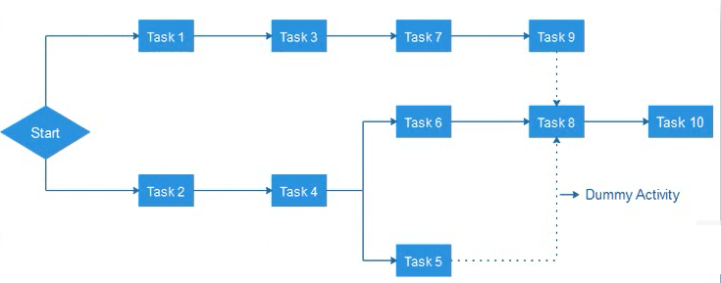
Project Scheduling Techniques
Program Evaluation and Review Technique (PERT):
It is a way to schedule flow of tasks in a project and estimate total time taken to complete it.
PERT charts offer a visual representation of the major activities (and dependencies) in a project
It calculate:
Optimistic time (0): Quickest time you can complete a project
Pessimistic time (P): Longest time it'll take to complete your project
Most likely time (M): How long it'll take to finish your project if there are no problems. • (0 + 4M + P)/6

Slide 16
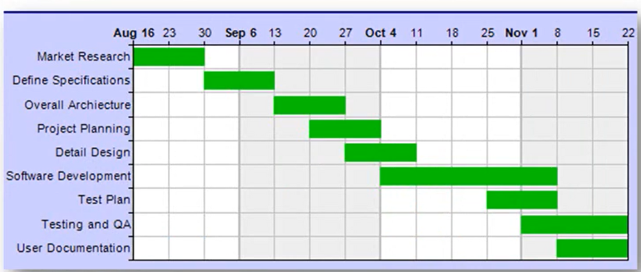
Project Scheduling Techniques
Gantt Chart:
A Gantt chart is a type of bar graph that project managers use for planning and scheduling in complex project.
It represent each task horizontally on a bar chart, which shows the start and end dates & they frequently include deadlines & dependencies of tasks.
It easier to visualize the progress of a project and see how different tasks interact with one another.

Slide 17
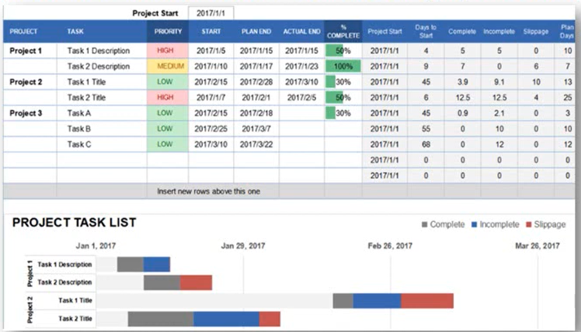
Project Scheduling Techniques
Task List:
One of the simplest project scheduling techniques is the creation of a task list.
Create task list using a word processor or spreadsheet software.
It create a list of tasks and include important intonation like the task manager, start date, deadline & completion status.

Slide 18
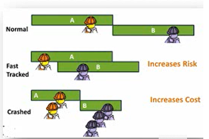
Project Scheduling Techniques
Fast Tracking :
In Fast Tracking, Project is being implemented by either simultaneously executing many tasks or by overlapping many tasks to each other.
Example: In software development project, designing and development can be taken up in parallel. Once design of essential features is ready and approved, development team can work on it. Meanwhile, the designing team will work on the remaining elements and functions.
Crashing:
Crashing deals with involving more resources to finish the project on time.
Example: Add more developer in project, Paying overtime to employee,
Crashing can only be applied when it fits your project budget.

